Slide 1

What effects Video Game Sales?
By Nathan Reed

Slide 2
Variables
Global_Sales: the total copies sold globally in millions.
JP_Sales: the total copies sold in Japan in millions.
NA_Sales: The total copies sold in North America in millions.
Critic_Score: The critics score of the game out of 100.
User_Score: Score out of 10 given to the game by a user of the game.

Slide 3
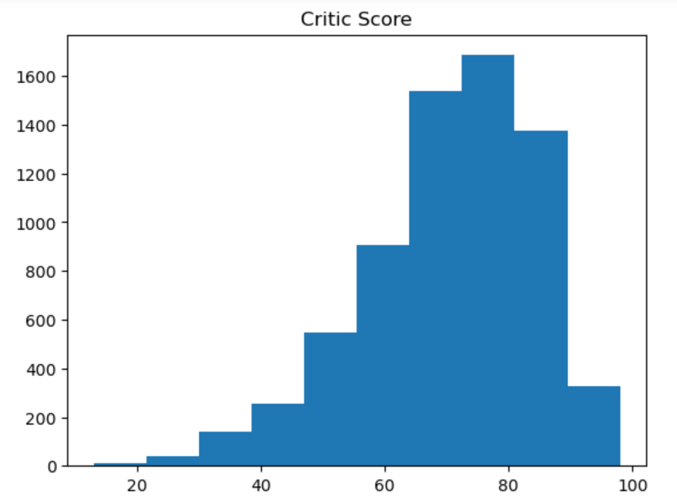
Critic_Score Histogram
Outliers- from this histogram there is not an obvious outlier. I would keep all from the values from this graph.
Mean- 70.3
Mode- 80.0
Spread:
Min: 13.0
25%: 62.0
50%: 72.0
75%: 80.0
Max: 98.0
Standard deviation: 13.9
Tail: The tail is left skewed as seen in the graph.

Slide 4
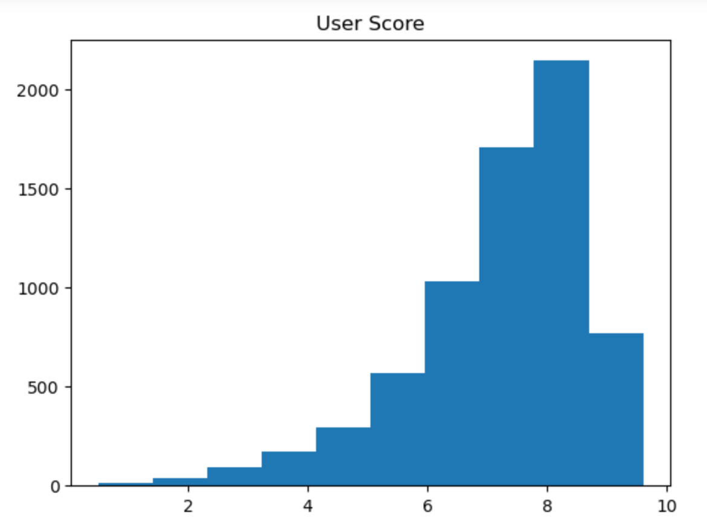
USER_Score Histogram
Outliers- from this histogram there is not an obvious outlier. I would keep all from the values from this graph.
Mean- 7.2
Mode- 7.8
Spread:
Min: 0.5
25%: 6.5
50%: 7.5
75%: 8.2
Max: 9.6
Standard deviation: 1.4
Tail: The tail is left skewed as seen in the graph.

Slide 5
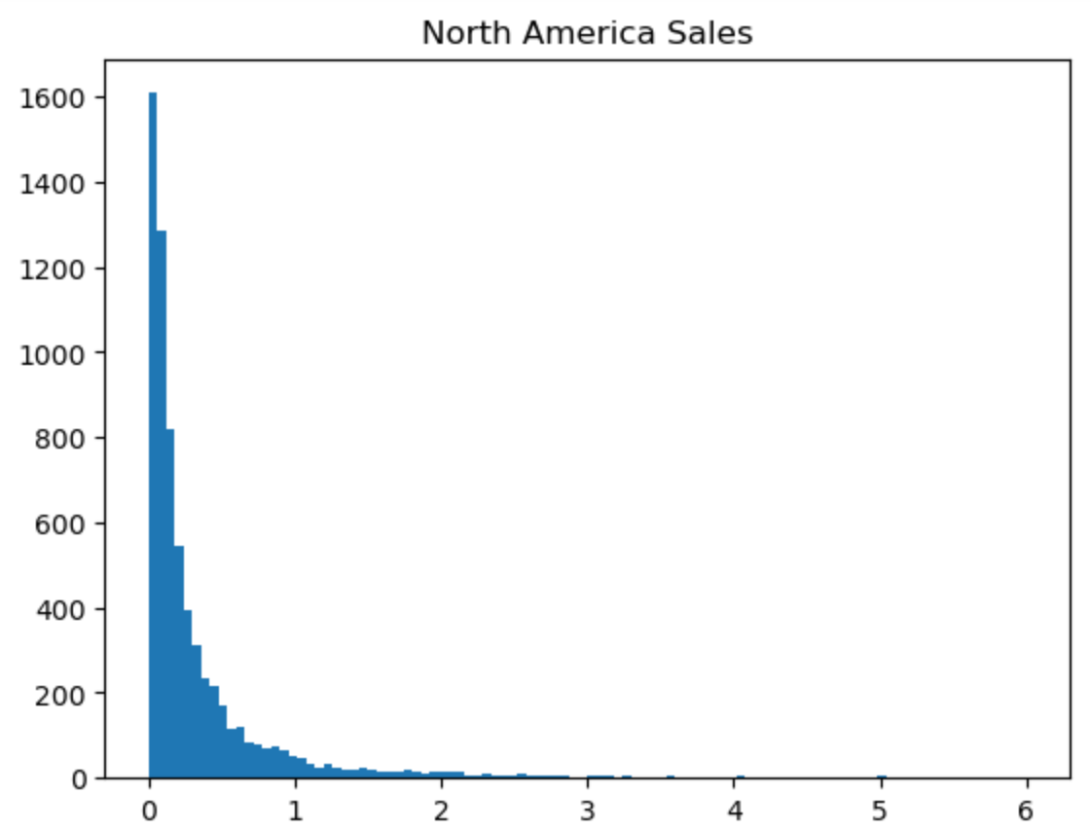
NA_Sales Histogram
Outliers- There are some outliers in this graph due to the wide ranges of numbers of copies sold. The graph originally was a lot longer and you could not see the graph very well. I decided to keep all outliers as it is a natural part of the population and will happen as certain games sell more than others.
Mean- 0.4
Mode- 0.0
Spread:
Min: 0.0
25%: 0.06
50%: 0.15
75%: 0.39
Max: 41.36
Standard deviation: 1.0
Tail: The tail is right skewed as seen in the graph.

Slide 6
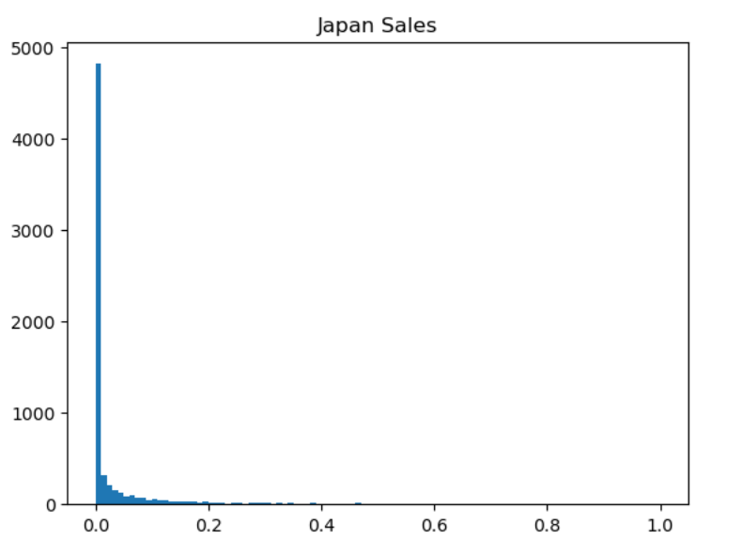
JP_Sales Histogram
Outliers- There are some outliers in this graph due to the wide ranges of numbers of copies sold. The graph originally was a lot longer and you could not see the graph very well. I decided to keep all outliers as it is a natural part of the population and will happen as certain games sell more than others.
Mean- 0.1
Mode- 0.0
Spread:
Min: 0.0
25%: 0.0
50%: 0.0
75%: 0.01
Max: 6.5
Standard deviation: 0.3
Tail: The tail is right skewed as seen in the graph.

Slide 7
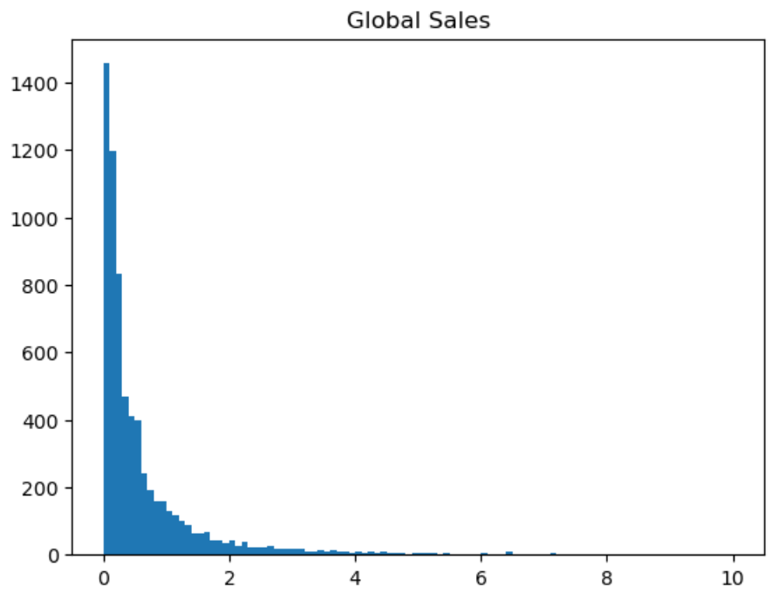
Global_Sales Histogram
Outliers- There are some outliers in this graph due to the wide ranges of numbers of copies sold. The graph originally was a lot longer and you could not see the graph very well. I decided to keep all outliers as it is a natural part of the population and will happen as certain games sell more than others.
Mean- 0.8
Mode- 0.02
Spread:
Min: 0.01
25%: 0.11
50%: 0.29
75%: 0.75
Max: 82.53
Standard deviation: 2.0
Tail: The tail is right skewed as seen in the graph.

Slide 8
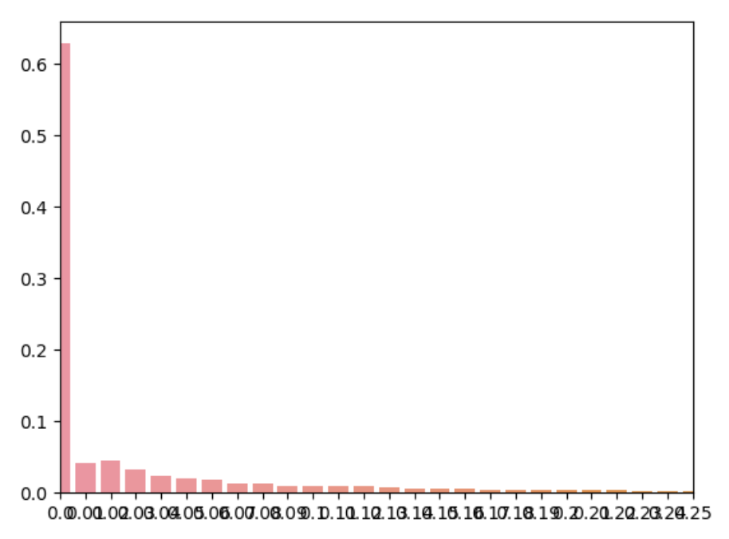
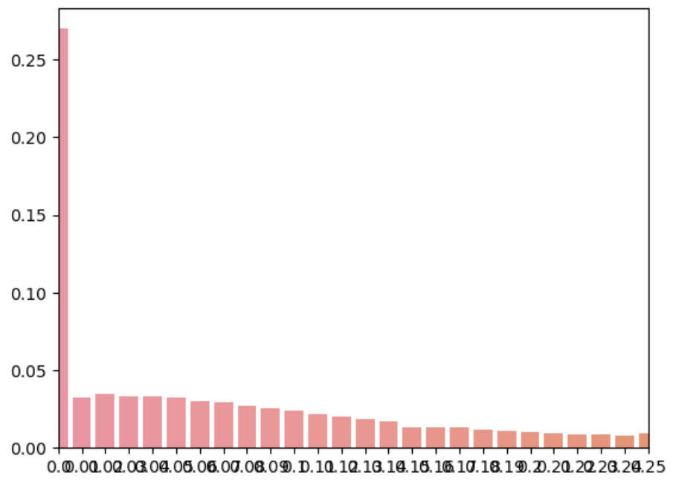
PMF JP_Sales Vs. PMF NA_Sales
Japan Sales PMF
North American Sales PMF
We can tell from these graphs that there are more sales in North America at higher values while at lower values there is more sales for Japan.

Slide 9
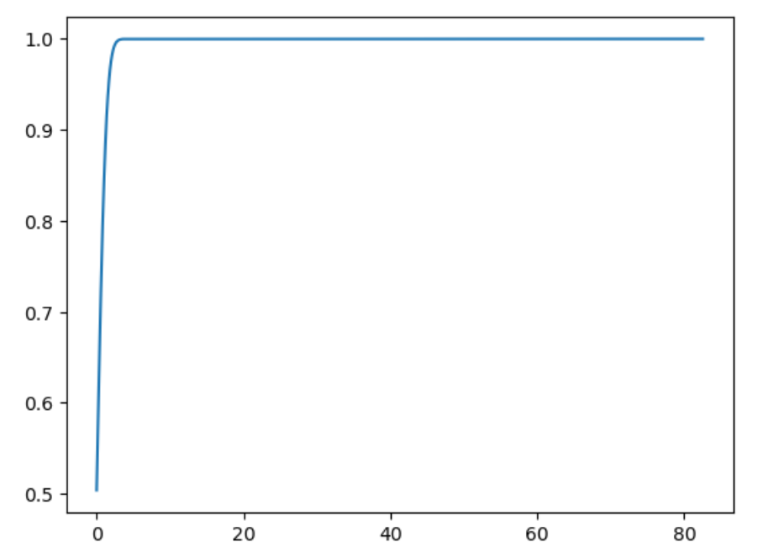
Global_Sales CDF
This CDF tells us that the grand majority of variables are between 0 and 1. This makes sense as we saw the histogram of Global_Sales as well as the spread and most of the spread was between 0 and 1.

Slide 10
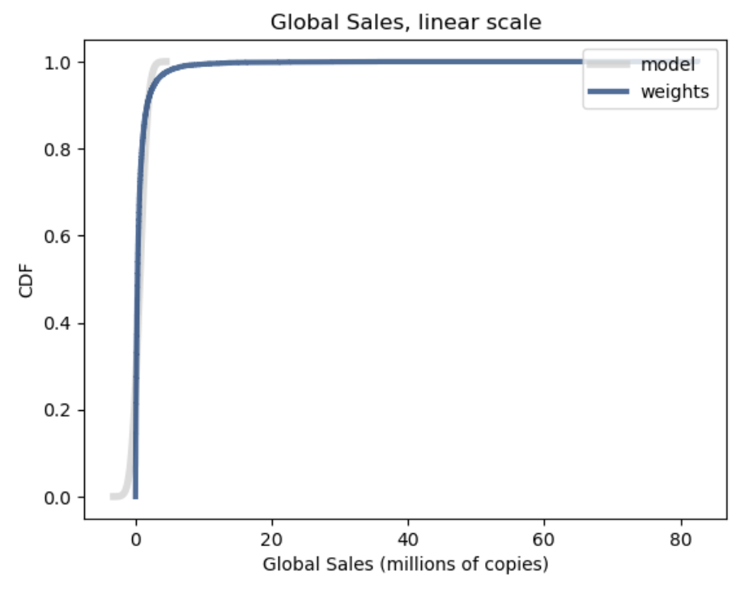
Log Normal Distribution
When I first looked at this graph, I definitely thought it was a Pareto Distribution. However, when I tried running variable on the distribution, it did not fit. I then new it had to be a log normal distribution. While it does not fit it perfect as seen in the bottom left of the graph, it fits a lot more than the pareto distribution.

Slide 11
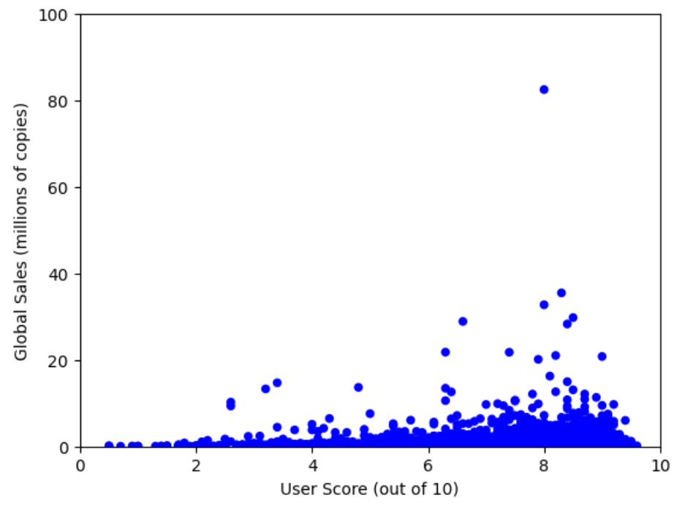
User_Score Vs Global_Sales
Covariance = 0.26
Correlation = 0. 086
Spearman Correlation = 0.008
The covariance tells us that there is almost no relationship between the two variables.
From this we can tell that correlation is very weak.
We can also see that the linear correlation is stronger than the rank correlation.

Slide 12
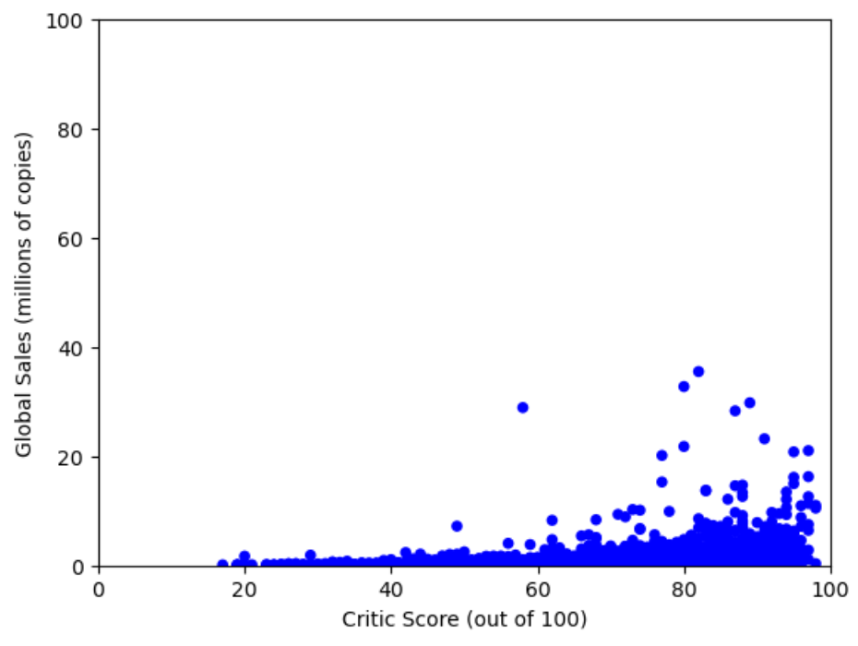
Critic_Score Vs Global_Sales
Covariance = 6.66
Correlation = 0.269
Spearman Correlation = 0.389
The covariance tells us that there is a lot more of a relationship between these variables than user_score.
From this we can tell that correlation is still weak, but not as weak as user_score.
We can also see that the linear correlation is weaker than the rank correlation.

Slide 13
Hypothesis Testing between Japan Sales and North American Sales
I used slope testing for my hypothesis test.
I got a significant p-value of 0.0
I thought this was strange as I didn’t think it would be that significant of a difference
I then looked up the population of North America and Japan and it made a lot more sense because North America has 4 times the population of Japan.

Slide 14
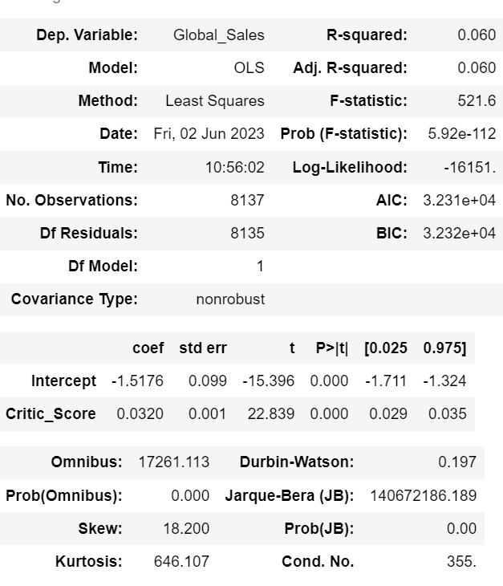
Simple Regression
I chose to do a Simple Regression model with the dependent variable being Global_Sales and the explanatory variable being Critic_Score.
From the r-squared we can tell that this model could be a lot better fitted with more variables.

Slide 15
Conclusions
Critic Score is more indicative of Global Sales than User Score.
North American Sales are significant compared to Japan’s sales.

